Slide 1
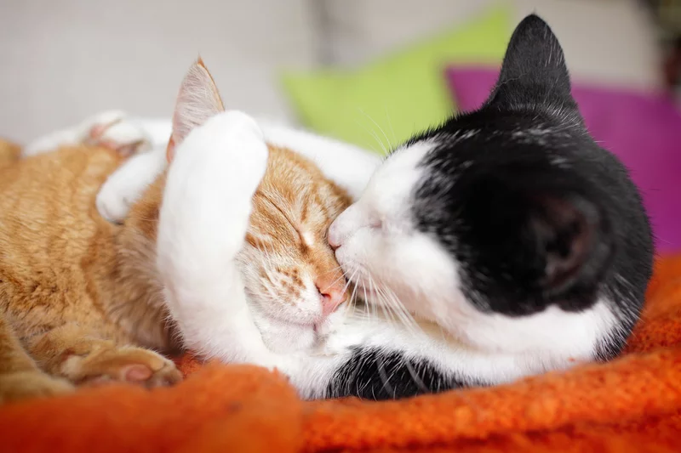
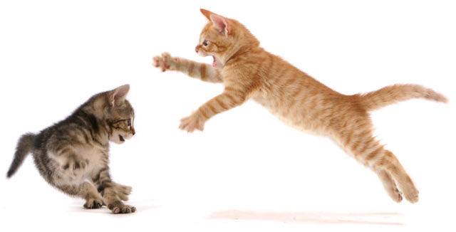
Local Programs and Associations

Slide 2
Why do this?
Implementation of CBC, MRT, and other mandates from UW-System
Better define roles and responsibilities of all parties; determine accountability.
Adjust alignment to current needs and issues
Develop necessary MOUs and update existing bylaws
Improve the functioning of both MGP and WIMGA; strengthen partnership
Better support the educators and volunteers at the local level for an improved program experience

Slide 3
Recent History

Slide 4
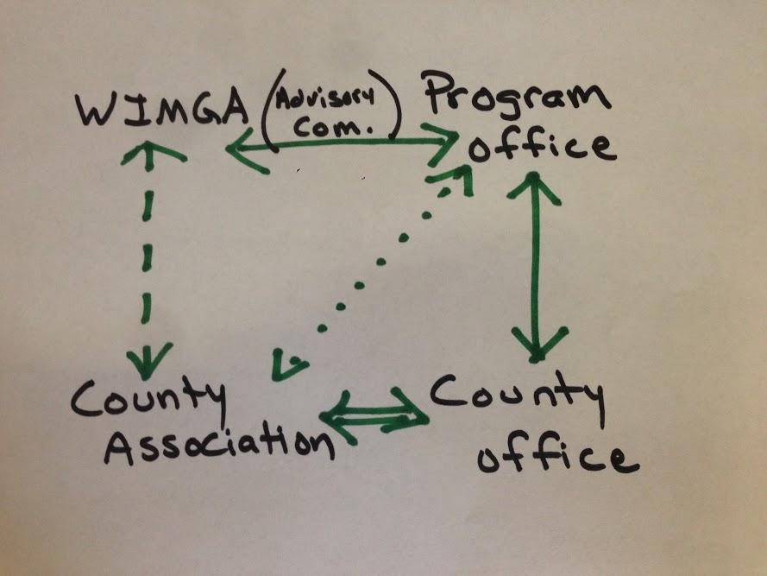
June 2014

Slide 5
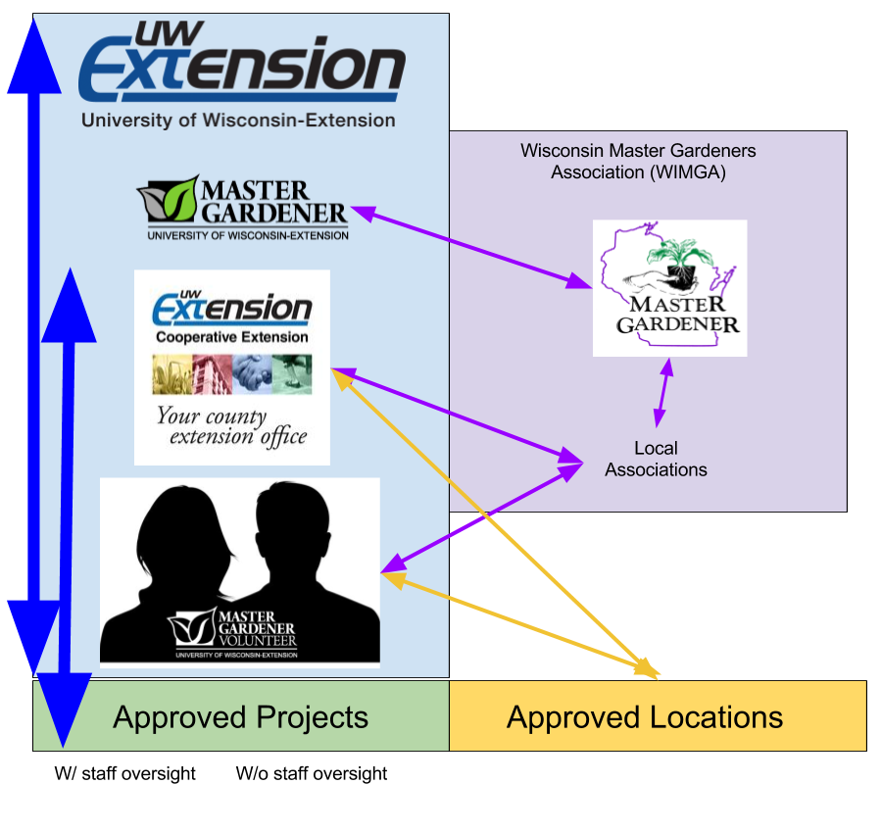
March 2015
(first version created, evolved)

Slide 6
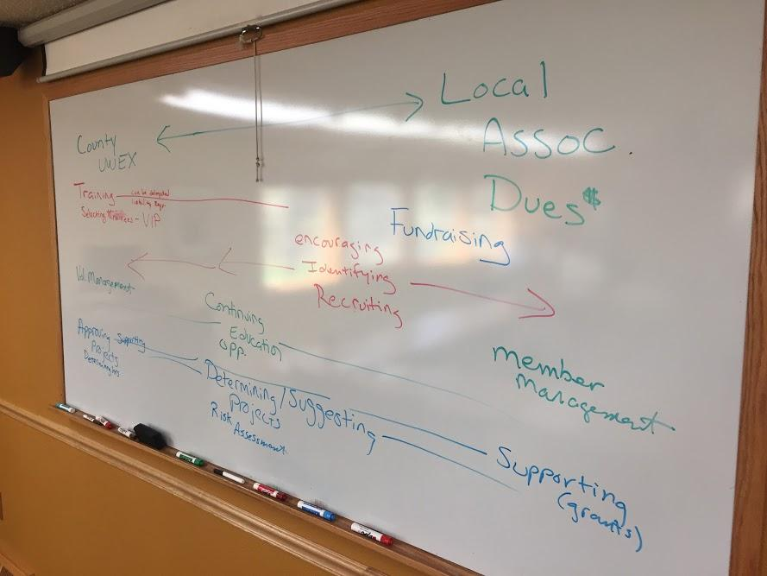
May 2017

Slide 7
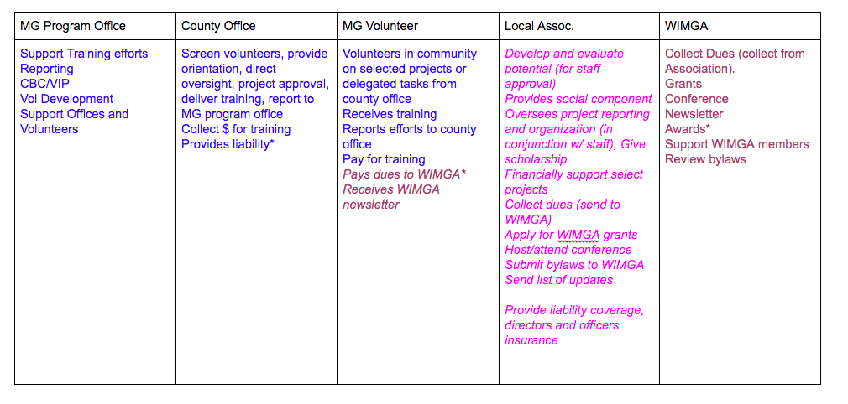
November 2017

Slide 8
Today’s Activity

Slide 9
 | Master Gardener Volunteer
What does Extension do? | LOCAL / COUNTY MG PROGRAM Workgroups | LOCAL / COUNTY ASSOCIATION Workgroups | What does WIMGA do?
 | Function
Description | Description | Description | Description

Slide 10
 | Master Gardener Volunteer
What does Extension do? | LOCAL / COUNTY MG PROGRAM Workgroups | LOCAL / COUNTY ASSOCIATION Workgroups | What does WIMGA do?
 | Function
Description | Description | Description | Description
Extension

Slide 11
 | Master Gardener Volunteer
What does Extension do? | LOCAL / COUNTY MG PROGRAM Workgroups | LOCAL / COUNTY ASSOCIATION Workgroups | What does WIMGA do?
 | Function
Description | Description | Description | Description
Extension
WIMGA

Slide 12
 | Master Gardener Volunteer
What does Extension do? | LOCAL / COUNTY MG PROGRAM Workgroups | LOCAL / COUNTY ASSOCIATION Workgroups | What does WIMGA do?
 | Function
Description | Description | Description | Description
Extension
WIMGA

Slide 13
Let’s do it!

Slide 14
 | Master Gardener Volunteer
What does Extension do? | LOCAL / COUNTY MG PROGRAM Workgroups | LOCAL / COUNTY ASSOCIATION Workgroups | What does WIMGA do?
 | Education
Training (Level 1, +) Requirement: complete Level 1 training and 10 hours of continuing education each year | Assist with Level 1 and continuing education needs of certified MGVs in county | Encouragement to participate and host statewide conference | Statewide Conference Speaker’s Bureau

Slide 15
 | Master Gardener Volunteer
What does Extension do? | LOCAL / COUNTY MG PROGRAM Workgroups | LOCAL / COUNTY ASSOCIATION Workgroups | What does WIMGA do?
 | Reporting
Certification & Reporting Requirement: Report efforts | Assist with collecting and tabulating hours; report, ensuring proper information is collected for annual report | Membership: Solicit member, Collect dues | Collect Dues

Slide 16
 | Master Gardener Volunteer
What does Extension do? | LOCAL / COUNTY MG PROGRAM Workgroups | LOCAL / COUNTY ASSOCIATION Workgroups | What does WIMGA do?
 | Projects
Approve Projects Requirement: for liability and USDA funding | Assist with review and vetting appropriateness of volunteer projects | WIMGA grants for projects, other financial support | Award grants

Slide 17
 | Master Gardener Volunteer
What does Extension do? | LOCAL / COUNTY MG PROGRAM Workgroups | LOCAL / COUNTY ASSOCIATION Workgroups | What does WIMGA do?
 | Communications
Communications Note: need to define for MOU ADA and non-discrimination requirements on all things with MGP logo on it--- including websites. | Assist with appropriate and timely updates related to local program; newsletters, social media, phone, email, website | Contribute to statewide WIMGA newsletter | Newsletter

Slide 18
 | Master Gardener Volunteer
What does Extension do? | LOCAL / COUNTY MG PROGRAM Workgroups | LOCAL / COUNTY ASSOCIATION Workgroups | What does WIMGA do?
 | Membership
Selection and Development of Volunteers Requirement: Liability, CBC, etc. Dues are not required at state level-- only continuing education, volunteer hours, and mandated forms define “membership” | Assist with formal and informal recognition of volunteer efforts; cards and other forms of appreciation | Mentor group, awards | Awards & Mentoring

Slide 19
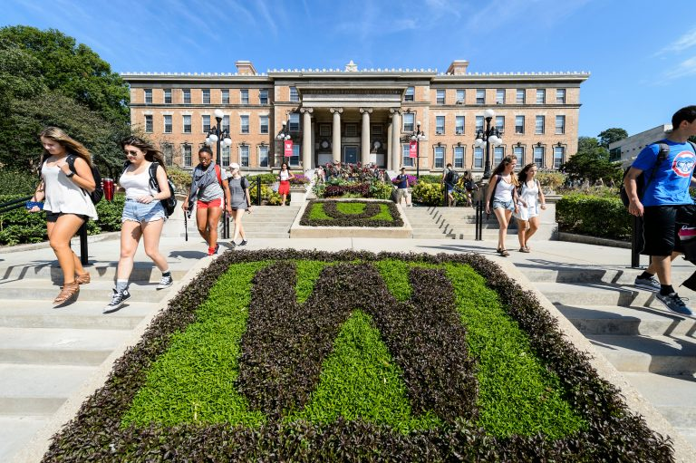
Next Steps:
Engage local groups in this conversation
Prepare for UW-Madison
MOUs
Define Volunteers
????

