Slide 1
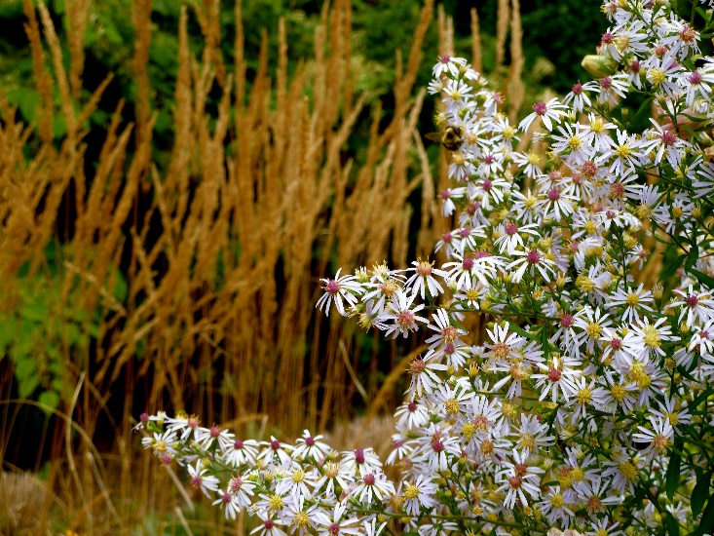
WIMGA
Wisconsin Master Gardeners Association
Established 1992

Slide 2
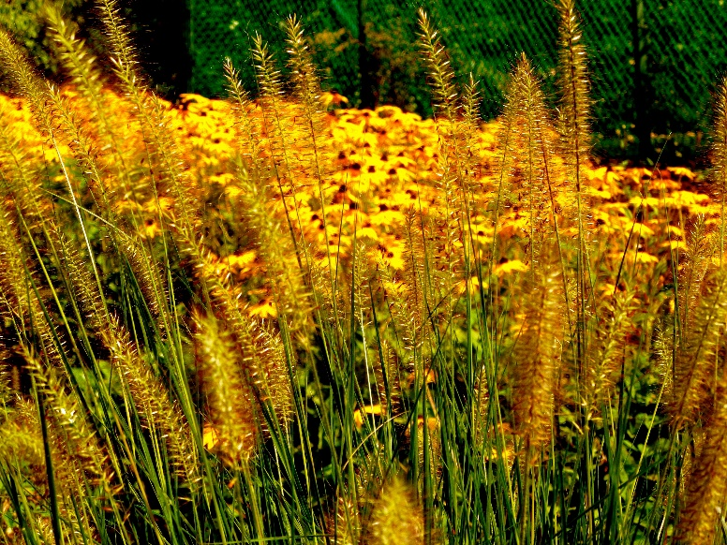
WIMGA VISION
The Wisconsin Master Gardeners Association will be the collective voice for the local Master Gardeners Associations and individual members in active support for their horticultural projects and services; build networks to enhance outreach, share ideas and promote projects; and help extend UW-Extension's educational role to the public.
Notes:
The WiMGA Visions was approved in 2016.
It serves as the framework for WIMGA’s three-year strategic plan.
- It helps promote WIMGA – who were are and what we do.

Slide 3
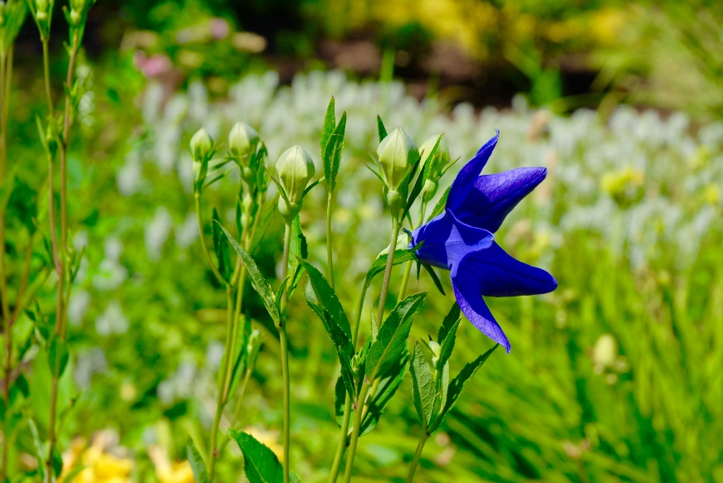
WIMGA
Statewide association
Established 1992
Communication link for Master Gardener Volunteers (MGVs) and the UW-Extension
Collective voice for recommendations to UW-Extension to assure best horticulture practices
Not to be confused with the Master Gardener Program
Notes:
- WIMGA is a statewide association formed in 1992 by MGVs around the state as a result of a statewide meeting held in Stevens Point.
- The WIMGA is the communication link between MGVs throughout the state and a voice for ideas and issues relating to the MGV Program.
- Members of the WIMGA Board of Directors sit on the WI MG Advisory Committee with UW-Extension Horticulture Specialists and Agents to recommend policy for the MGV Program.
- WIMGA should not be confused with the Master Gardener Program. The MG Program is a separate entity, with its own set of responsibilities for MGVs. To learn more about the MG Program go to their website at www.wimastergardener.org

Slide 4
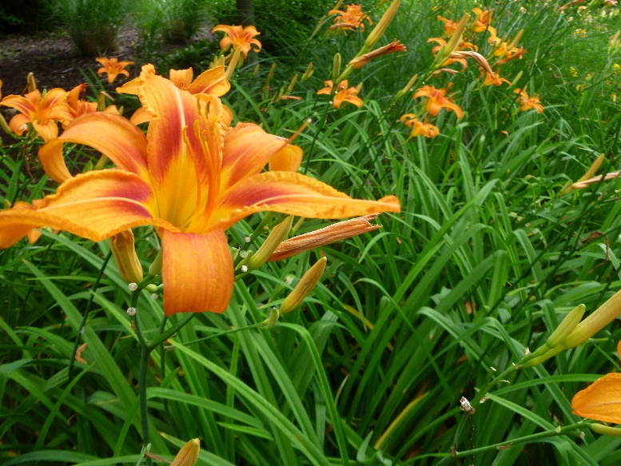
WIMGA Board of Directors
Governing body
Certified Master Gardener Volunteer & WIMGA Member
Fifteen (15) Directors
Twelve (12) District Directors
Represent the MGVs and Associations in their district
Three (3) At-Large Directors
Represent MGVs statewide
Notes:
- All Board members are certified Master Gardener Volunteers; attend all Board meetings; participate at WIMGA Annual Conference(s), participate in at least one WIMGA working committee, and share the work of WIMGA with their respective local associations.
- The twelve (12) District Directors give regional geographic representation based on the six (6) WIMGA Districts to the WIMGA Board and represent those associations in those districts. District Directors are chosen by their Local Representatives
- The three At-­Large Directors are elected by the membership of WIMGA as a whole and represent all MGVs in the state, especially those who are independent of any member association of WIMGA. The At-­Large Directors do not need to be a Local Representative but must be a Certified Master Gardener Volunteer in good standing.

Slide 5
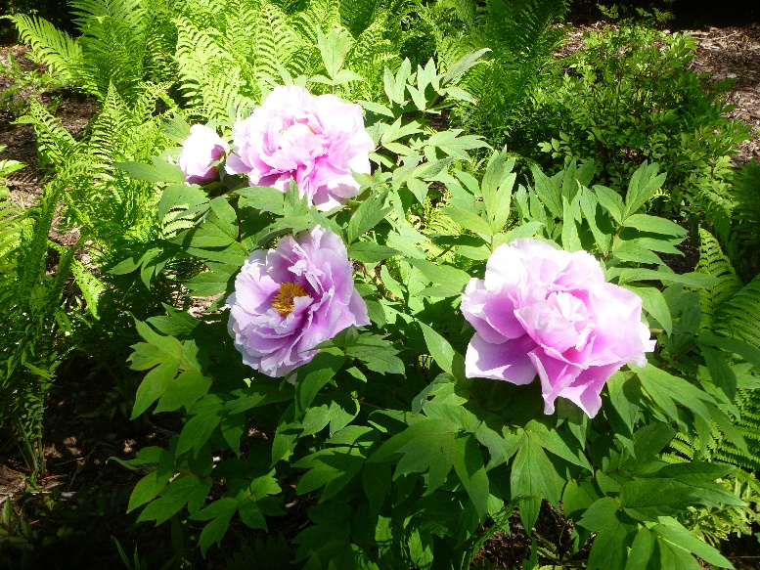
WIMGA Districts
Northern
Central
Western
Eastern
Southern
Southeast Urban
Cluster
Notes:
The six WIMGA Districts

Slide 6
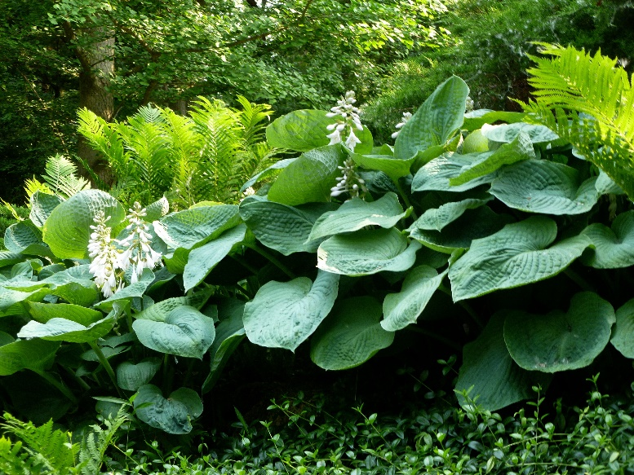
WIMGA Local Representatives
Selected by their Local Association
Recognized contact person
Responsibilities
Relay information
Attend face-to-face meetings of the WIMGA board
Participate/lead WIMGA sponsored strategic initiatives
Notes:
Local Representatives are selected by their respective Local Association, must be a certified Master Gardener Volunteer in good standing.
- Term limits are determined by each Local Association. If a Local Representative vacates his/her position, the Local Association must designate a replacement within sixty (60) days.
Local Representatives share information from WIMGA to their local associations and bring to the Board any issues of concern from their local associations that need to be addressed.
They also make certain local treasurers send in yearly dues and addresses of members, provide the WIMGA Secretary with a current list of the local association’s officers, participate on any of the WIMGA committees and/or strategic initiatives as a member with full rights on that committee.
- They attend the spring and fall face-to-face meetings of Locals Representatives with the WIMGA Board., and participate on any of the WIMGA committees and/or strategic initiatives as a member with full rights on that committee.

Slide 7
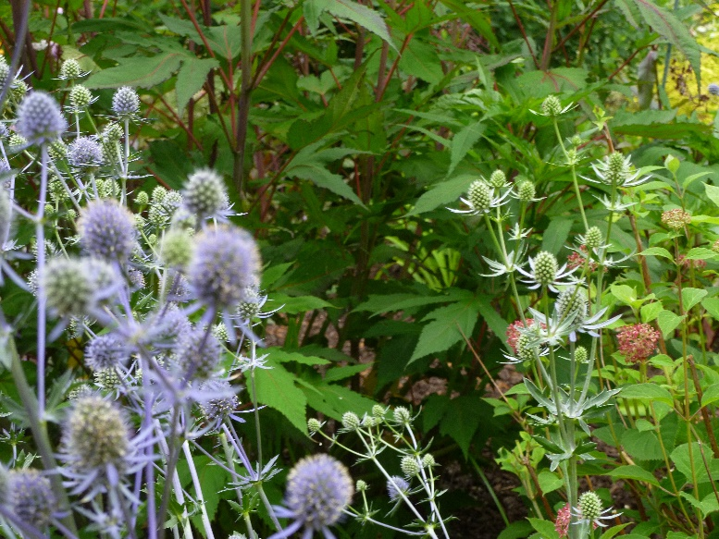
WIMGA Membership
Local Associations
Individuals
Annual Dues - $5/person
Notes:
- A local association may join WIMGA by petitioning the State Association for admission in writing. The steps and information that would need to be provided can be found on the WIMGA website.
- MGVs not affiliated with local associations send their dues directly to the WIMGA current Treasurer by January 15 of each year.
- There are many local MG associations that belong to the WIMGA. There are also active MGVs who are individual members of the WIMGA but do not yet have a local association in their area. There are also some active MG groups and individuals in WI who are not yet members of the WIMGA.
- WIMGA dues are $5 per person. It is the responsibility of each Local Association’s Treasurer to assure dues are paid by January 15 of each year and sent to WIMGA’s Treasurer along with a list of current paid members. MGVs not affiliated with local associations need to send their dues directly to the WlMGA Treasurer by January 15 of each year.
- Membership dues are used towards numerous programs supported by WIMGA.

Slide 8
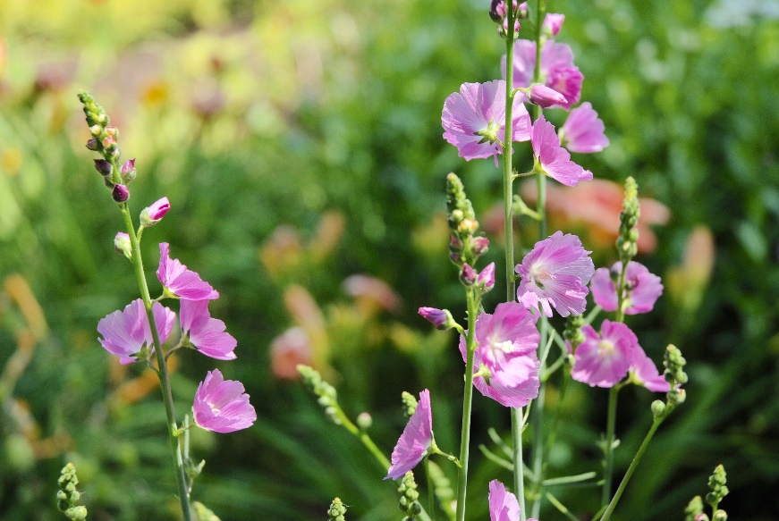
WIMGA Newsletter
Published six (6) times per year
Sent to WIMGA Members
Mail
Electronically
Notes:
- The WIMGA Newsletter is a bimonthly publication (Jan, March, May, July, September, November) about MGV associations activities written by MGVs. It includes information about WIMGA, WIMGA activities, or information relevant to local associations. MGVs learn about projects in other counties, places to visit, and educational programs making an impact on Wisconsin communities.
- The newsletter is sent through email or direct mail from the Master Gardener Program office to WIMGA dues paying members.
- WIMGA dues help offset the cost of mailing the newsletter.

Slide 9
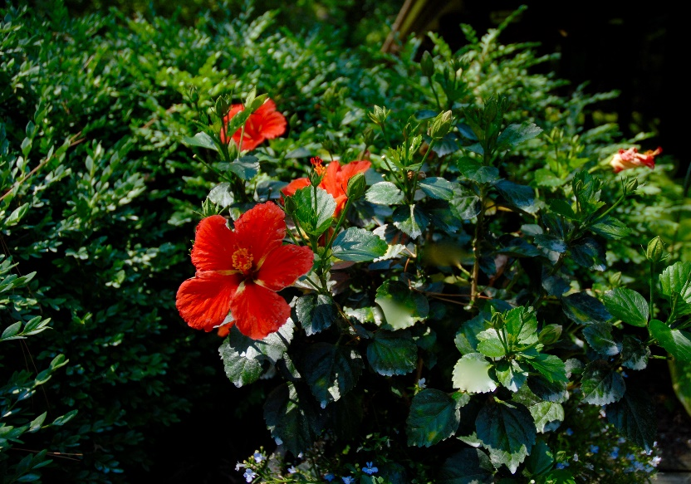
WIMGA Financial Support
Grants for MGV community projects
Garden Talk on Wisconsin Public Radio (WPR)
National Junior Horticultural Association (NJHA)
Wisconsin Junior Horticulture Association
Wisconsin Master Gardener Foundation
Notes:
- Membership dues and other funds are used to support numerous programs.
- Wisconsin Public Radio is a civic and cultural resource that exists to enlighten and enrich the quality of life for its listeners. During the program “Garden Talk” host Larry Miller discusses gardening topics with his guests. WIMGA donates to WI Public Radio to support Larry and “Garden Talk.” In the first year of support, we donated $1000 and that support has grown to the current level of support - $5000. The WIMGA Board of Directors feel very positive about supporting WPR and the “Garden Talk” Program.
- Another area of support has been the National Junior Horticulture Association and the WI Junior Horticulture Association. The National Junior Horticultural Association (NJHA) was founded in 1934 and was the first organization in the world dedicated solely to youth and horticulture.
- On the national level, WIMGA sponsors the “Writing in Horticulture” Contest, which includes Poetry, Creative Writing and Informative Writing in three separate age categories – age 10 – 14; age 15 – 18 and age 19 -22. Cash awards are presented to the winners. Young people from all over the United States attend this conference and participate in the many different contests.
- In Wisconsin, we support the young people who qualify and attend the national conference each year in a different are of the nation.
The past president of NJHA is from Wisconsin and over the years, many youth from our state have held offices in NJHA.
Contributions to the Master Gardener Foundation provides support to improve educational programs and training materials and continue program office activities, in order to maintain the strong tradition of quality education and assistance to individual MGVs and local MG associations in their mission to assist UW-Extension in community horticultural programs through volunteerism, education and environmental stewardship.
WIMGA provides educational grants for MGV community projects

Slide 10
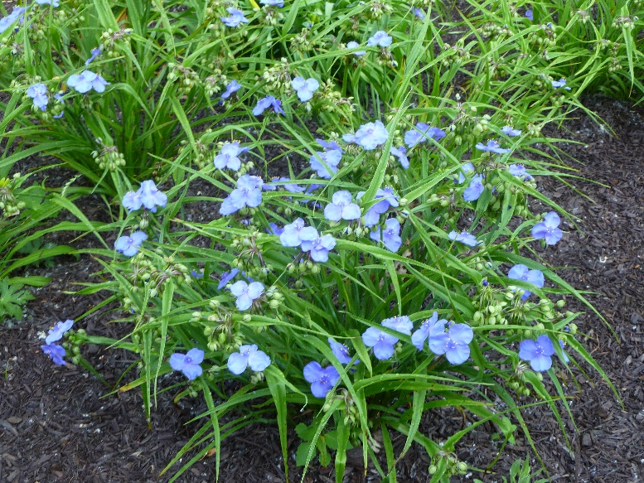
WIMGA Educational Grants
Support community education
Provide grants to Master Gardener Associations in their respective communities
Three grants levels
$100
$250
$400
Notes:
- The WIMGA awards several grants annually to Master Gardener associations to aid their efforts in community education. Applications for each of the three levels of funding are due by October 1 of each year..
- Proposals are submitted to the WIMGA Finance Committee.
- Local associations use the grants for a variety of things, including community projects, project supplies, brochures, bus tours, educational materials, LCD projector and camera.
- Grant applications can be found on the WIMGA Website.

Slide 11
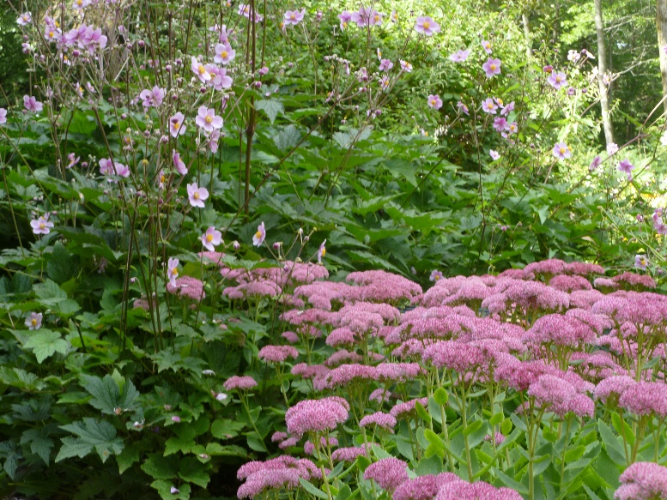
WIMGA Annual / Regional Conference
Acts as venue for WIMGA Annual Meeting
Provides educational seminars with state-of-the-art horticulture practices
Offers networking opportunity for MGVs
Serves as primary WIMGA fundraiser
Notes:
- The WIMGA Annual Conference is hosted by WIMGA in partnership with local association(s). The Annual Meeting of the WIMGA is held at the Annual Conference.
- The Conference provides educational opportunities for MGVs, and a chance for MGVs to network with each other.
- If a local association is interested in hosting the Annual Conference, they must complete an application that can be found on the WIMGA Website.
- The profit or loss from any WlMGA-­sponsored conference with a local association is divided equally.

Slide 12
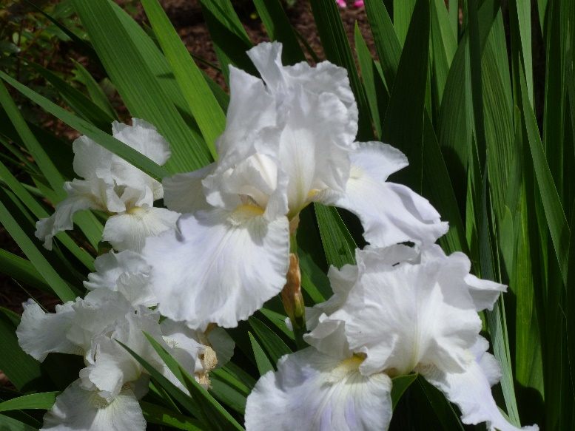
WIMGA – Key Strategies
Collective Voice
Website
Newsletter
Marketing
Board Manual
Strong Networks
Collaborative Practices
Awards and Recognition Program
Mentoring Program
Speakers’ Bureau
Notes:
WIMGA has four key strategies:
Be the Collective Voice for our Master Gardeners Local Associations and individual members
- Build a website to better communicate with MGV’s throughout the state.
- Produce a bimonthly WIMGA Newsletter to share articles written by MGVs about their projects and accomplishments.
- Raise awareness of WIMGA and Master Gardener Voluntters in general to the public.
- Maintain a Board Manual that gives guidance and work practices to the management of WIMGA.
Build Strong Networks Among Local Associations
Promote collaboration among associations
Create a process to help associations with WIMGA members’ recruitment and retention.
Develop tools such as the WIMGA Mentoring Program to help local associations run smoothly, retain members, and carry out projects.
Create a Speakers’ Bureau listing speakers from throughout the State who can present educational sessions at local meetings or conferences. The Speakers Bureau will be available on the WIGMA Website.

Slide 13
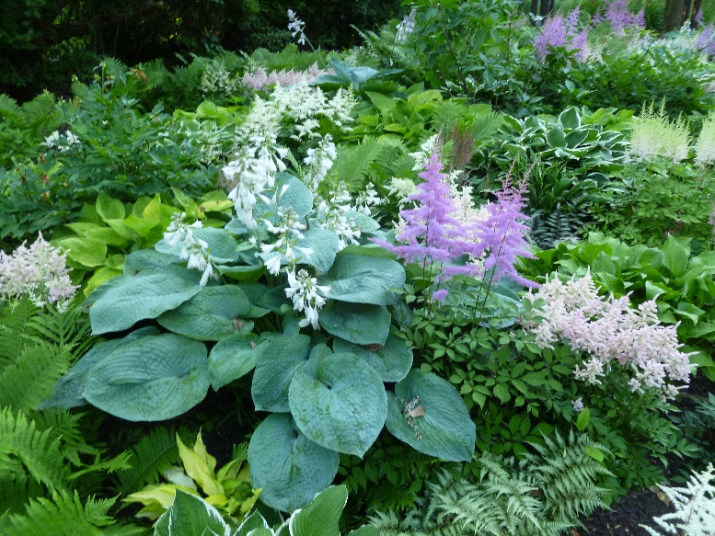
WIMGA – Key Strategies
Partnership with UW-Extension
Champion best horticulture practices
Help extend UW-Extension’s educational role to the public
Serve as members of the UW-Extension Advisory Committee
Fiscal Accountability
Align Grants to Support Projects
Treasurer’s Column for WIMGA Newsletter
Notes:
Partnership with UW-Extension
- Be an active partner with UW-Extension to assure best horticulture practices and offer feedback regarding training practices.
Fiscal Accountability
- Align WIMGA grants to support projects/activities that result in the greatest community impact
- Provide a bimonthly Treasurer’s Column for the WIMGA Newsletter offering updates and tools for treasurers of local associations.

Slide 14
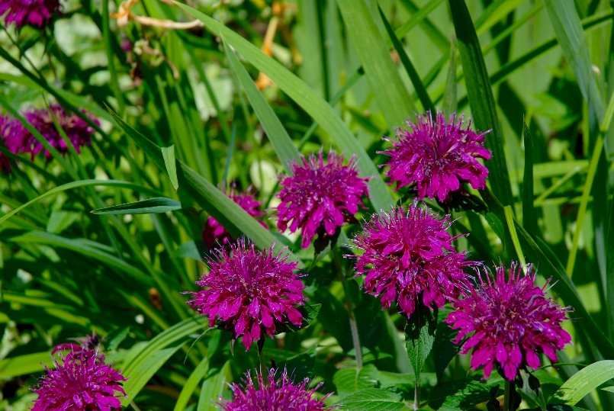
WIMGA Website: www.wimga.org
Membership Dues
Grants
Conferences
List of Board of Directors
List of Local Representatives
Documents
Notes:
The WIMGA website is where you will find information regarding:
Membership Dues – how much dues are, when they are due, where to send them
Grants – grant application
Conferences – information on hosting the annual WIMGA conference
Documents – bylaws, SOP, grant application, printable list of board of directors and local reps, sample forms for associations to use.

Slide 15
Developed by Chris Jacobs, WIMGA Director-at-Large
The Wisconsin Master Gardeners Association (WIMGA) works in behalf of its WIMGA members in providing tools/services to support their volunteer horticulture activities throughout the state. http://www.wimga.org
Copyright. All rights reserved.

